Slide 1
11. Light & Colour
Dr. Hamish Carr & Dr. Rafael Kuffner dos Anjos

Slide 2

Agenda
Physics of Light.
Interactions between light and the environment
Integrating radiance
Types of light
Color theory
Color spaces
COMP 5812M: Foundations of Modelling & Rendering

Slide 3
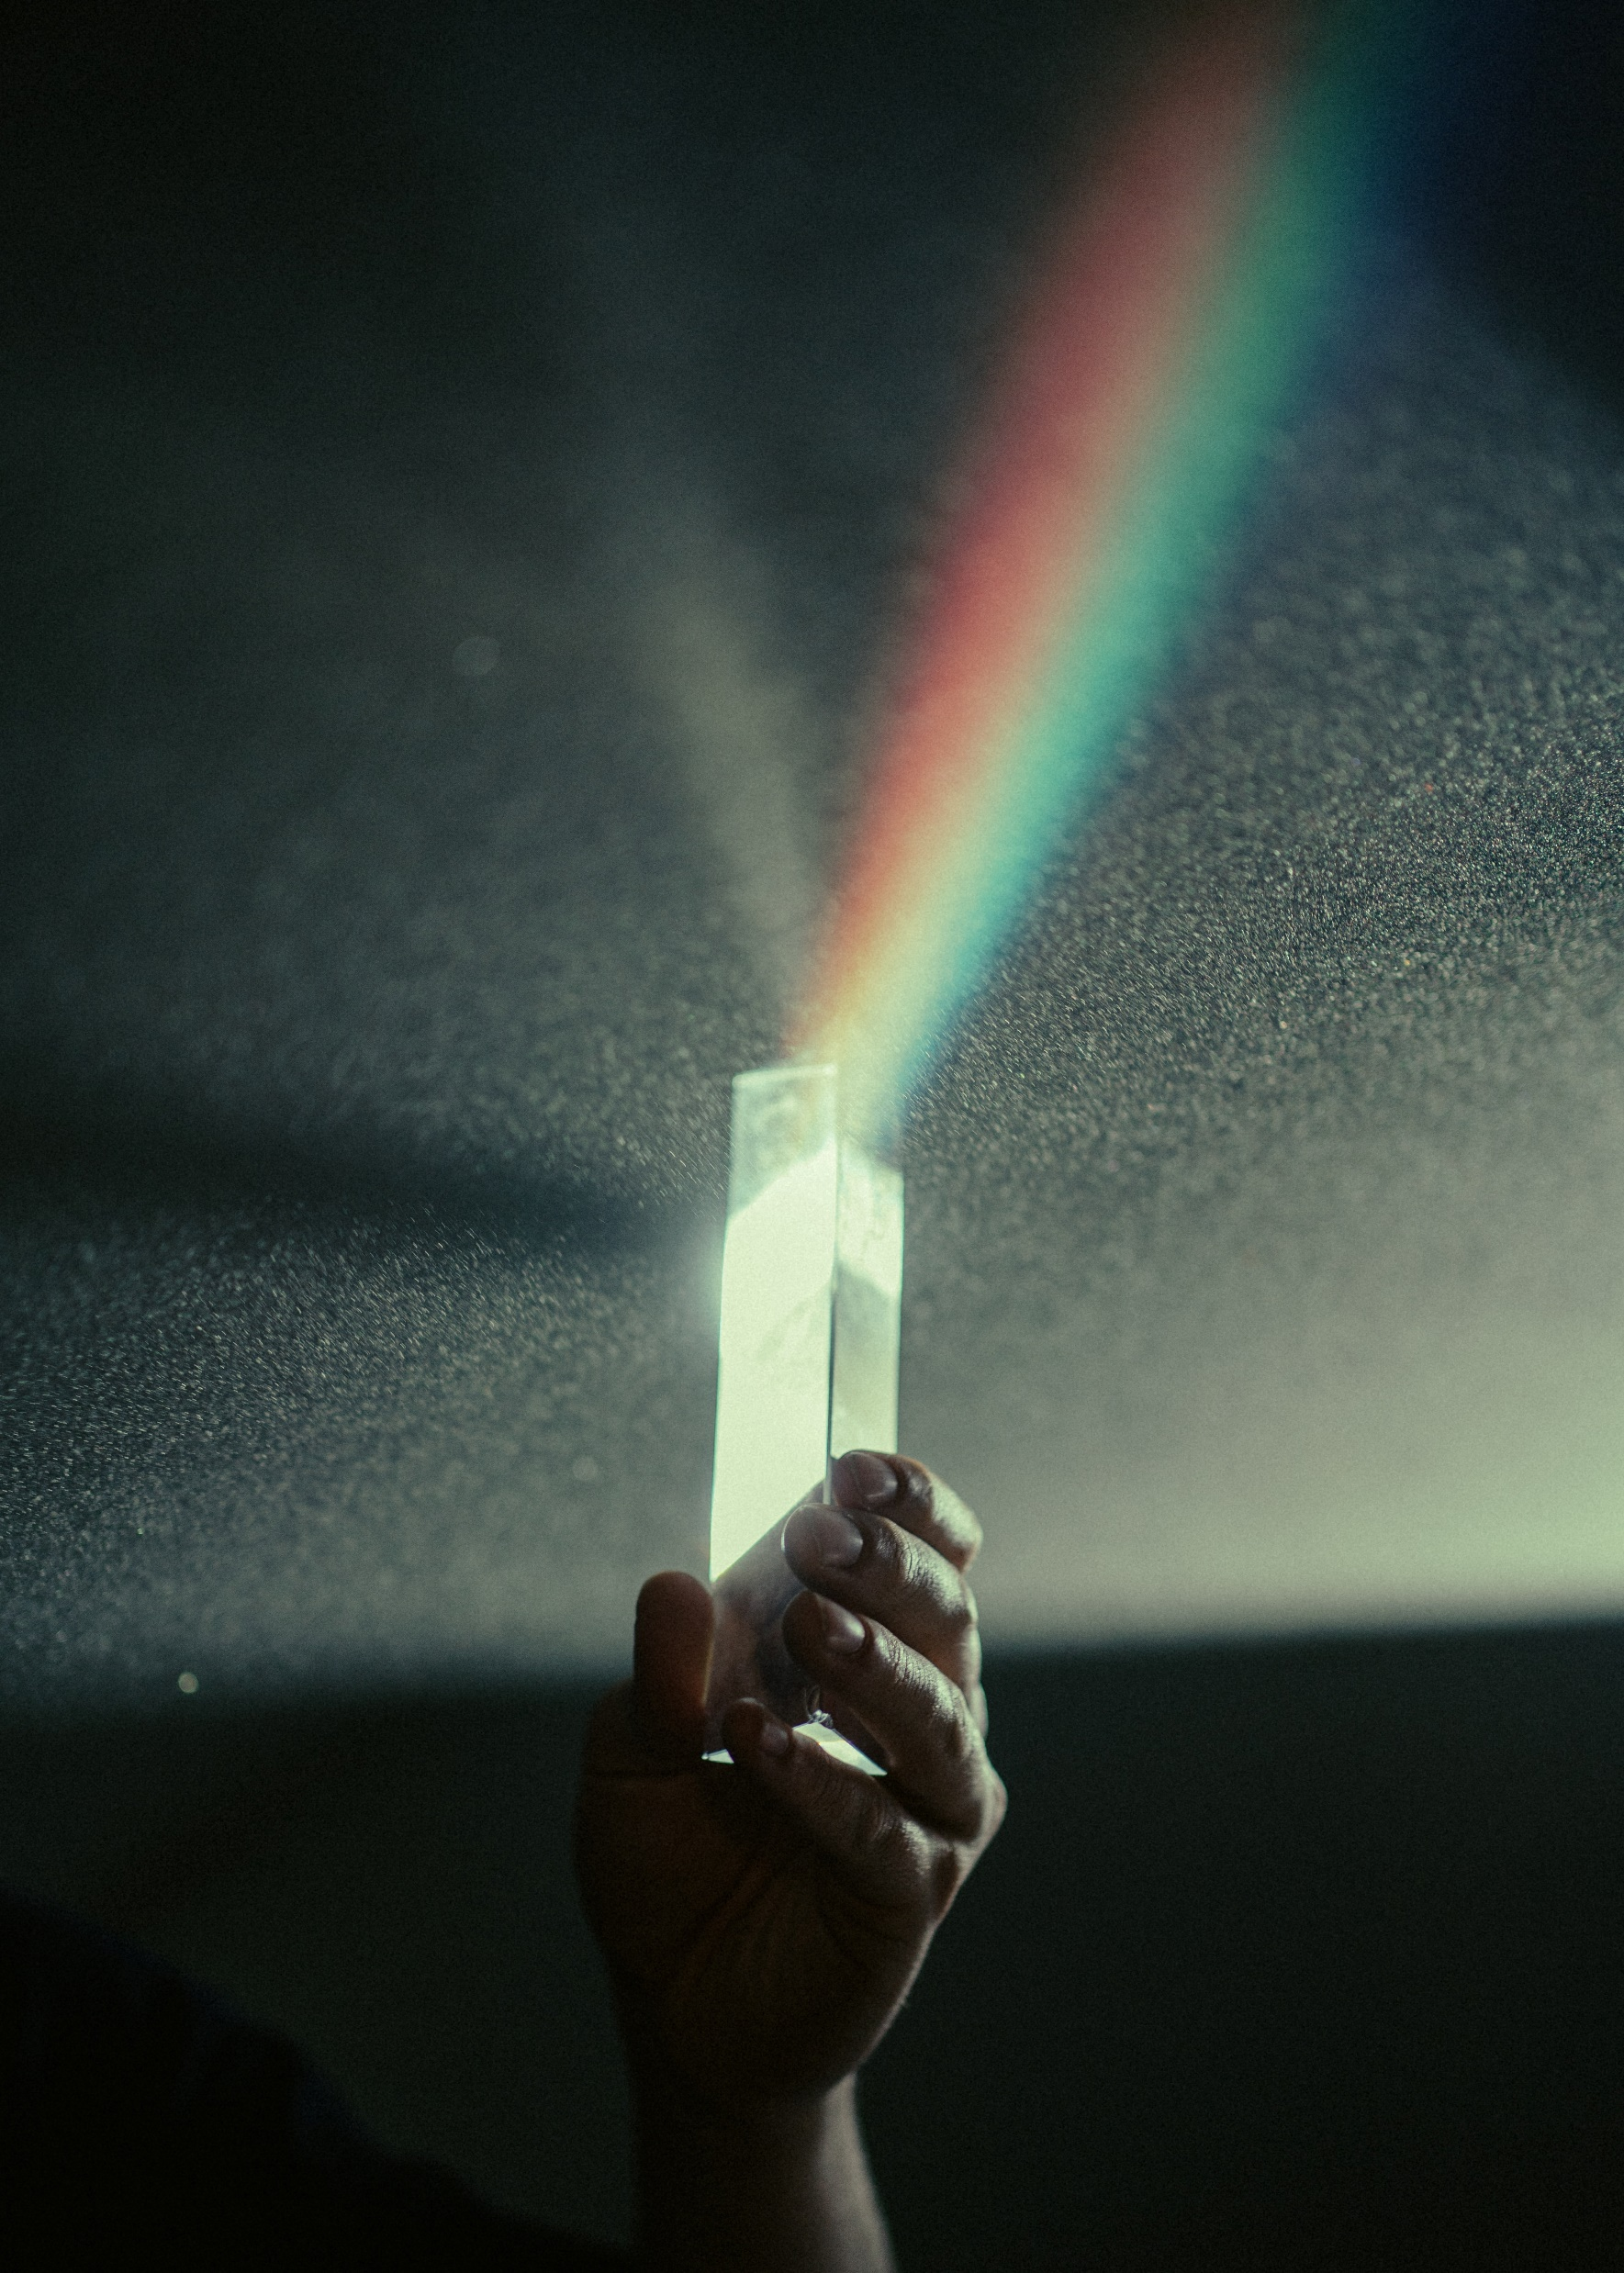
What's the Difference?
Light is a physical phenomenon
Photons of varying wavelength
A spectral distribution
Colour is a perceptual phenomenon
How the human eye interprets it
Based on the rods and cones in the eye
What you learned in school is simplified
COMP 5812M: Foundations of Modelling & Rendering

Slide 4
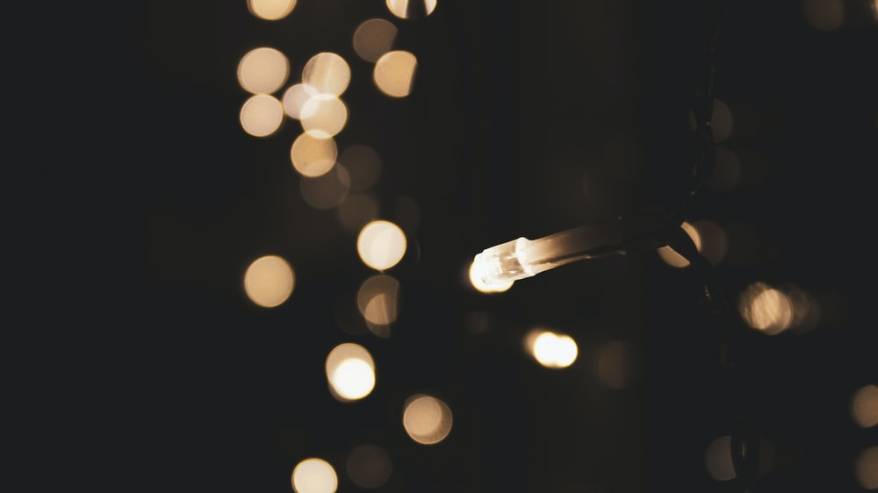
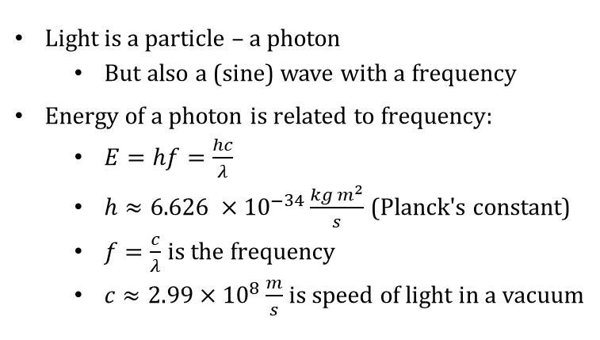
Photons
Light is a particle – a photon
But also a (sine) wave with a frequency
Energy of a photon is related to frequency:
$E=hf=\frac{hc}{λ}$
$h≈6.626 ×{10}^{−34}\frac{kg m^{2}}{s}$ (Planck's constant)
$f=\frac{c}{λ}$ is the frequency
$c≈2.99×{10}^{8}\frac{m}{s}$ is speed of light in a vacuum
COMP 5812M: Foundations of Modelling & Rendering

Slide 5
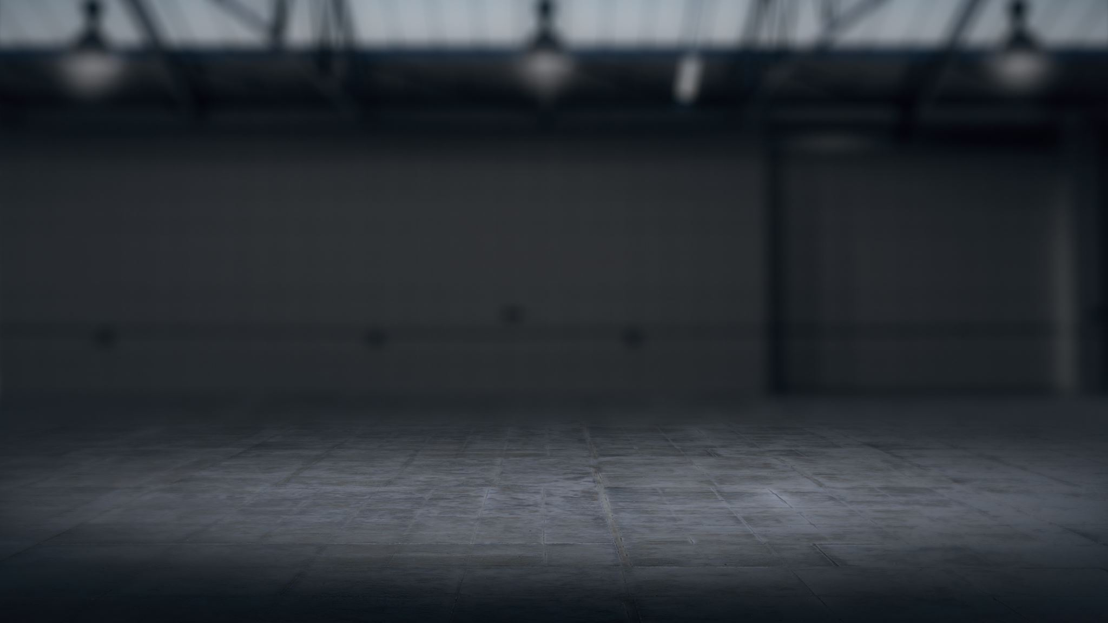

Units for Light
Energy ($J$) depends on wavelength
Power ($W$) is energy/unit time
Irradiance ($W/m^{2}$) is power/unit area
Also known as radiosity
Radiance ($W/m^{2}sr$) is irradiance/unit angle
Conserved along a ray
Defers inverse-square law to surface
COMP 5812M: Foundations of Modelling & Rendering

Slide 6
Why This Matters
Thin films generate rainbows of colour
Many other phenomena also affected

Slide 7
Atomic Orbitals
Electrons orbit atoms
Fixed radii called orbitals
Related to electron energy
Electrons capture photons
Jump to higher orbitals
Or they release photons
Drop to lower orbitals

Slide 8
Photon Frequencies
Single atom – very strict orbitals
Photons have specific frequencies
Blocks of material have roaming electrons
So they have bands of frequencies
But photons still restricted to these bands

Slide 9
Electron Effects
Electrons may be tightly or loosely bound
Tight: photon released at same frequency
Loose: photon released at lower frequency
Spare energy absorbed as heat
Reflective material ⬄ conductors
Transparent material ⬄ insulators

Slide 10
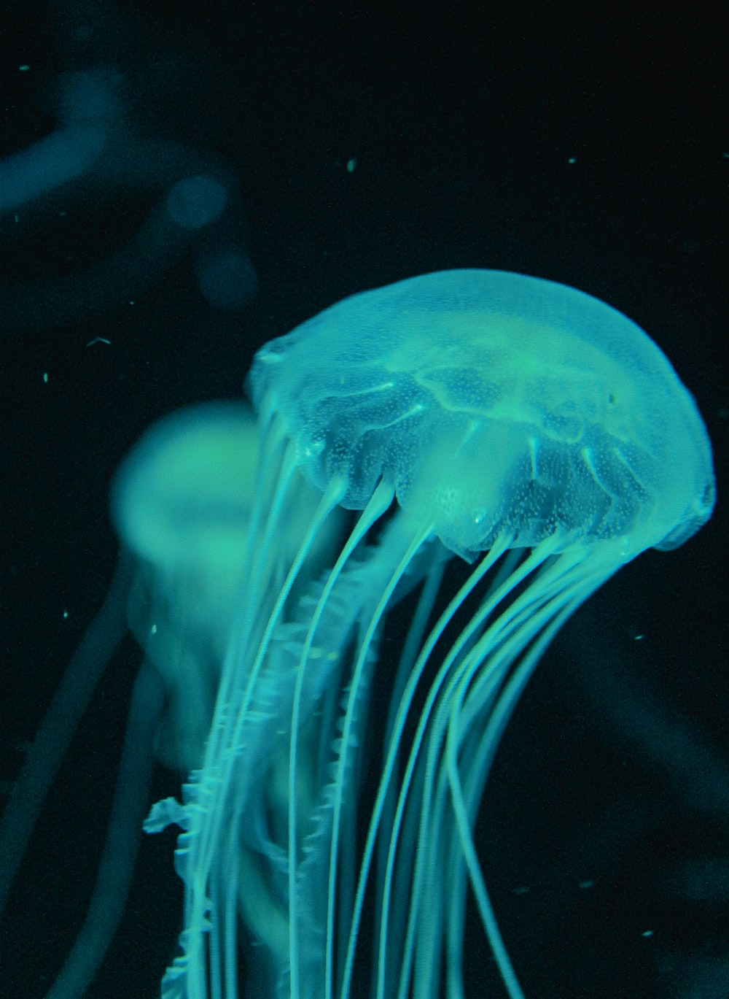
Fluorescence
Energy absorbed, transformed to heat
Electron releases lower-energy photon
Lower energy => lower frequency
Lower frequency => different colour
UV light can drop to visible light
Fluorescence
COMP 5812M: Foundations of Modelling & Rendering

Slide 11
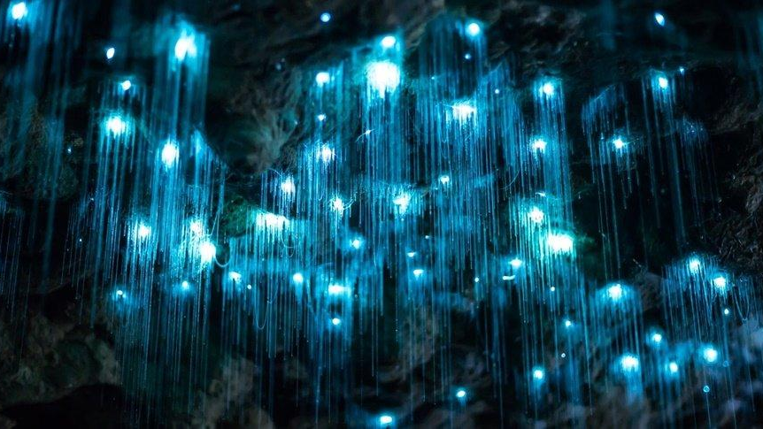
Time Delays
Photon re-radiation is not immediate
There is a time lag
Small lag + re-emission of identical photon
Means the effective speed of light is slower
Different materials => different speeds
Known as virtual transition
Large lag + energy loss
Phosphorescence
COMP 5812M: Foundations of Modelling & Rendering

Slide 12
Carbon
Carbon has loosely bound electrons
Can absorb photons of many frequencies
Store energy in vibrations (heat)
Dark materials warm up
Reverse this to generate photons
Heat up soot so atoms vibrate
They start kicking out photons

Slide 13
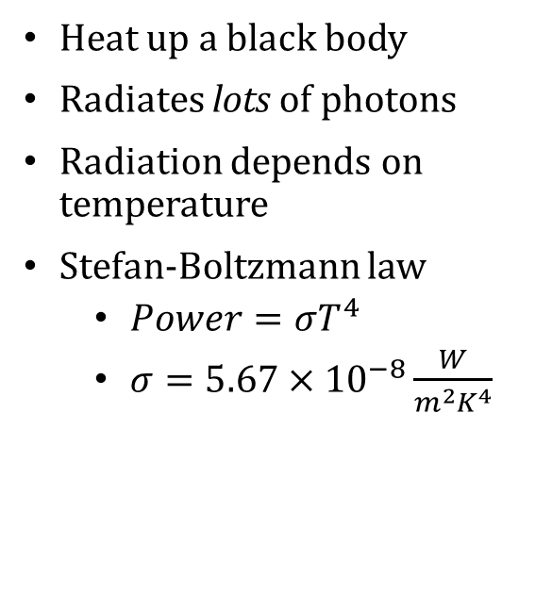
Black-body Radiation
Heat up a black body
Radiates lots of photons
Radiation depends on temperature
Stefan-Boltzmann law
$Power=σT^{4}$
$σ=5.67×{10}^{−8}\frac{W}{m^{2}K^{4}}$

Slide 14
Wave Nature of Light
Photons also behave like waves
wave length – distance between peaks
wave velocity – speed of peaks
COMP 5812M: Foundations of Modelling & Rendering

Slide 15
Planar Waves
Generalisation of sine waves to space
Light wave has an associated electric field
So, a wave along x-direction is:
All others are just rotations of this

Slide 16
Diffraction
At one distance D
At all distances
Waves passing through a slit diffract
depending on width of slit

Slide 17
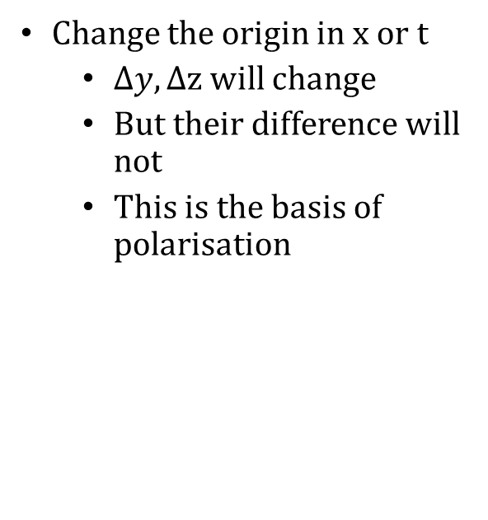
Polarisation
Change the origin in x or t
$∆y, ∆$z will change
But their difference will not
This is the basis of polarisation

Slide 18
Circular Polarisation
y,z are out of phase
Represents a helical light wave
Projection sideways gives sine, cosine
Projection forward gives a circle
COMP 5812M: Foundations of Modelling & Rendering

Slide 19
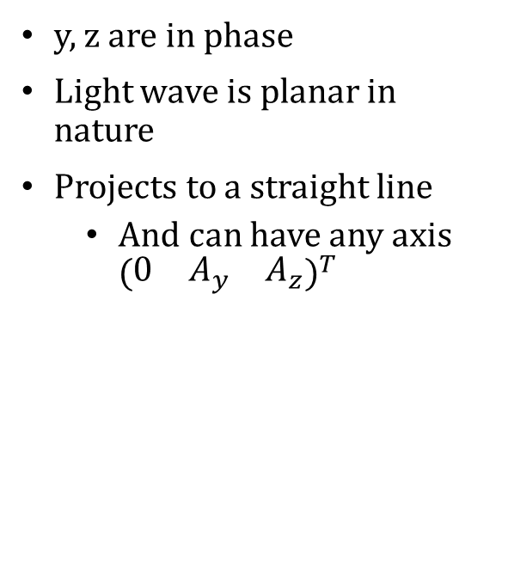
Linear Polarisation
y, z are in phase
Light wave is planar in nature
Projects to a straight line
And can have any axis ${\left(\begin{matrix}0 & A_{y} & A_{z}\end{matrix}\right)}^{T}$
COMP 5812M: Foundations of Modelling & Rendering

Slide 20
Elliptical Polarisation
Any other case
a combination of circular and linear
COMP 5812M: Foundations of Modelling & Rendering

Slide 21
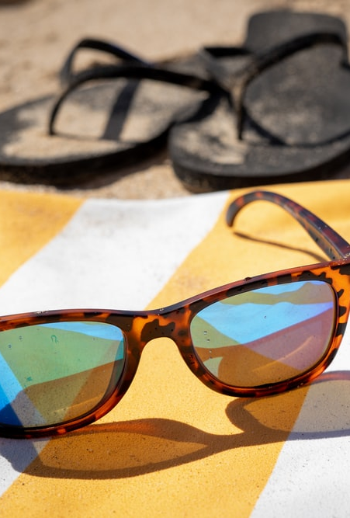
Polarising Material
Some material is polarising
Transparent to one polarisation
Opaque to opposite polarisation
Commonly used for driving glasses
Also used in LCD screens
And in monitor glass
More in a few minutes ...
COMP 5812M: Foundations of Modelling & Rendering

Slide 22
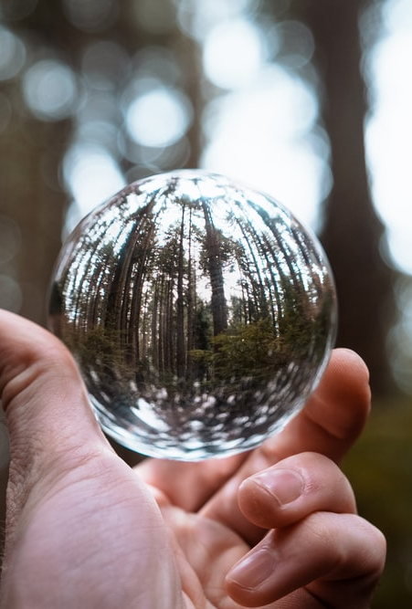
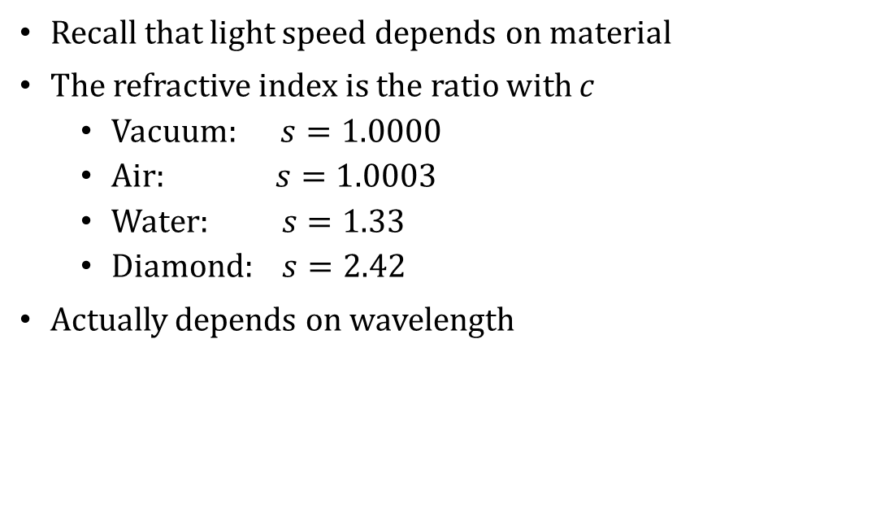
Refractive Index
Recall that light speed depends on material
The refractive index is the ratio with c
Vacuum: $s=1.0000$
Air: $s=1.0003$
Water: $s=1.33$
Diamond: $s=2.42$
Actually depends on wavelength
COMP 5812M: Foundations of Modelling & Rendering

Slide 23
Wave Retardation
Uniform
Slowed on One Side
As waves slow down, they bunch up
Frequency is constant, wavelength changes
Slowing one side changes the direction

Slide 24
Snell's Law
Waves retard based on angle
So this rotates the wave
Based on indices of refraction
COMP 5812M: Foundations of Modelling & Rendering

Slide 25
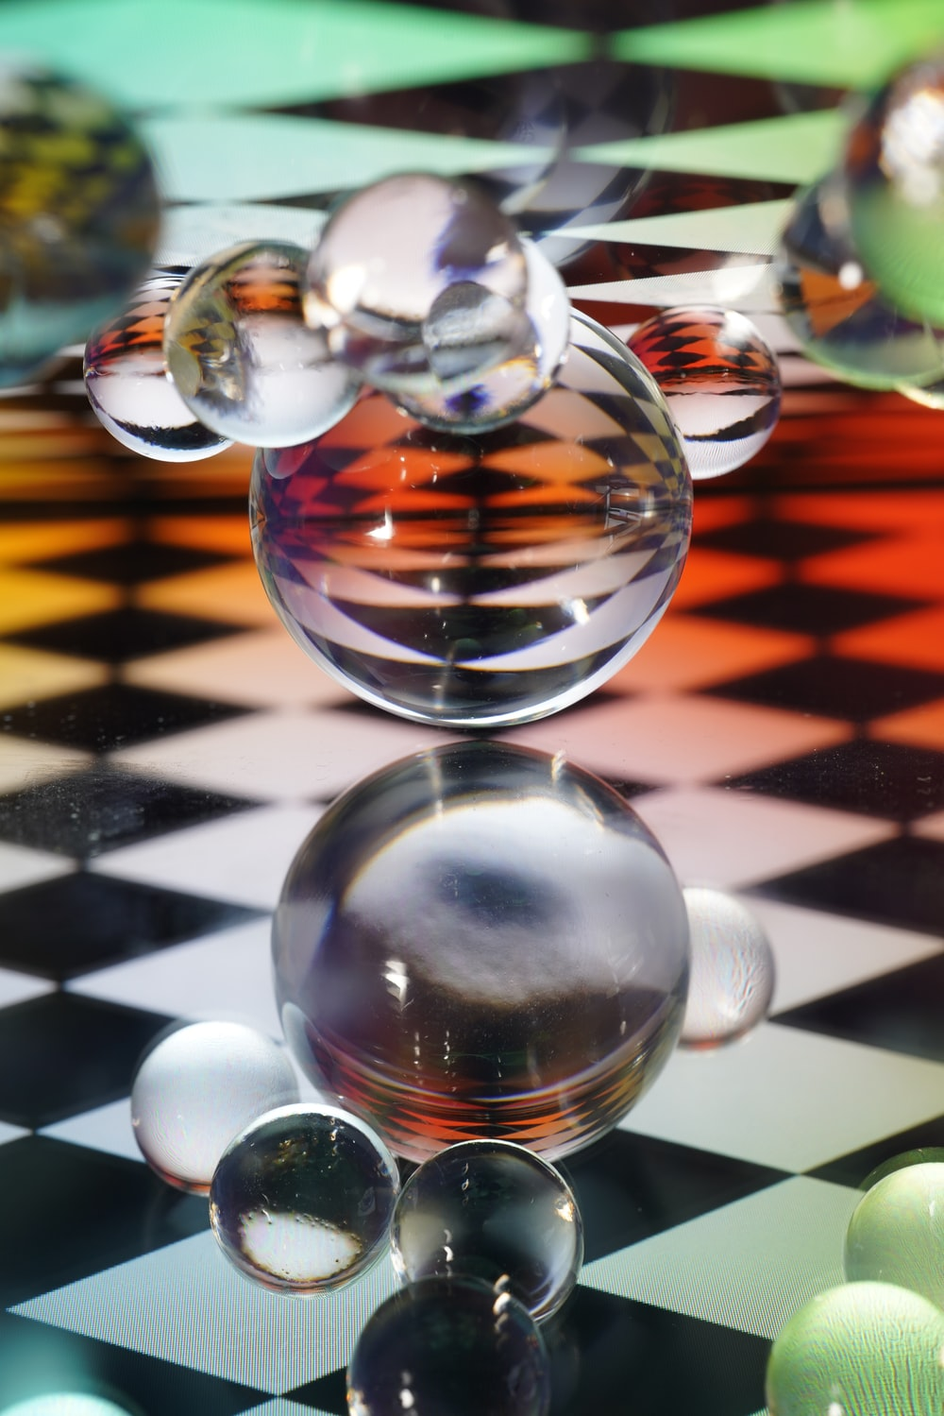
Reflection & Refraction
Not all light can refract
So energy must go somewhere
Reflection
Refraction
Absorption
Governed by Fresnel equations
COMP 5812M: Foundations of Modelling & Rendering

Slide 26
Polarised Reflection
Light reflected gets polarised
p-polarisation:
parallel to surface
perpendicular to page
s-polarisation:
perpendicular to light
in plane of page

Slide 27
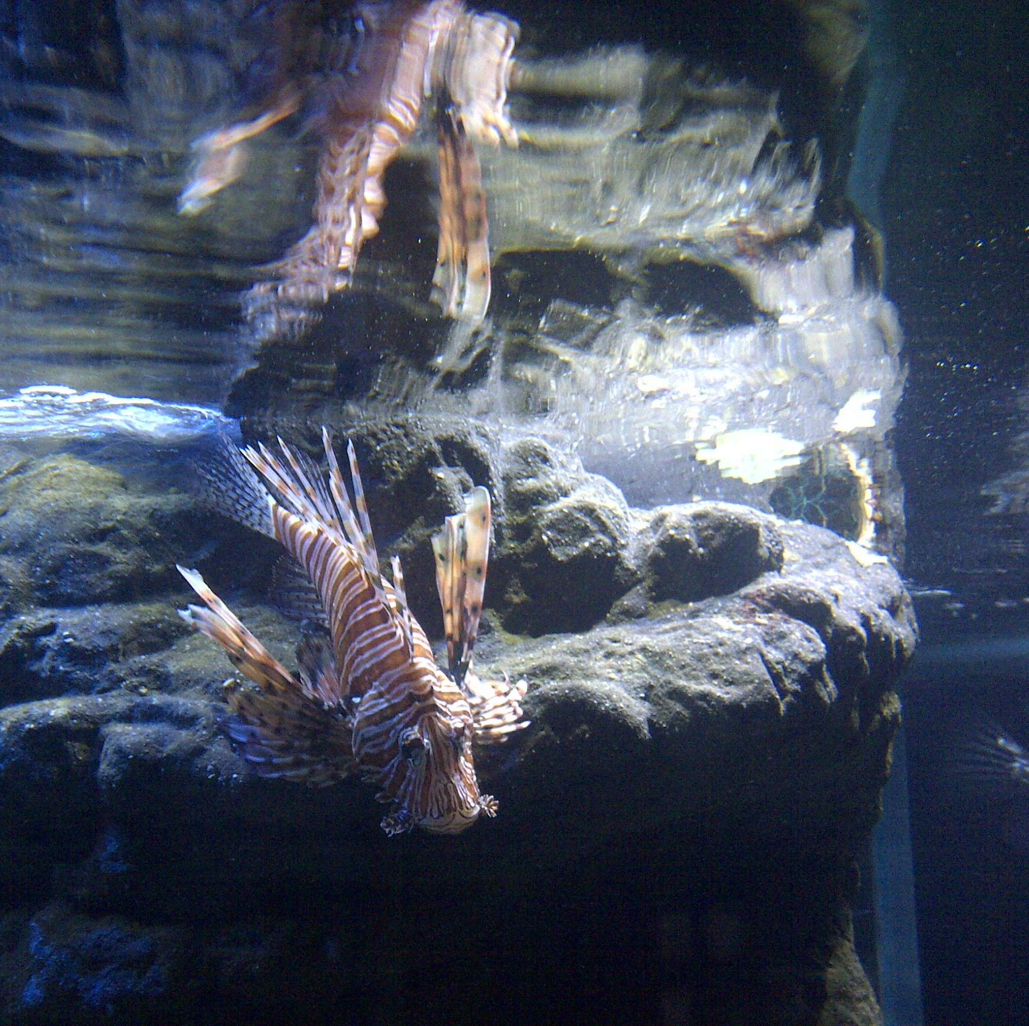
Total Internal Reflection
If angle is too steep, light cannot transmit
All light reflects internally
Basis of lenses, &c.
COMP 5812M: Foundations of Modelling & Rendering

Slide 28
Refractive Effects
CD-ROMs
Rainbows
Sundogs
Caustics

Slide 29
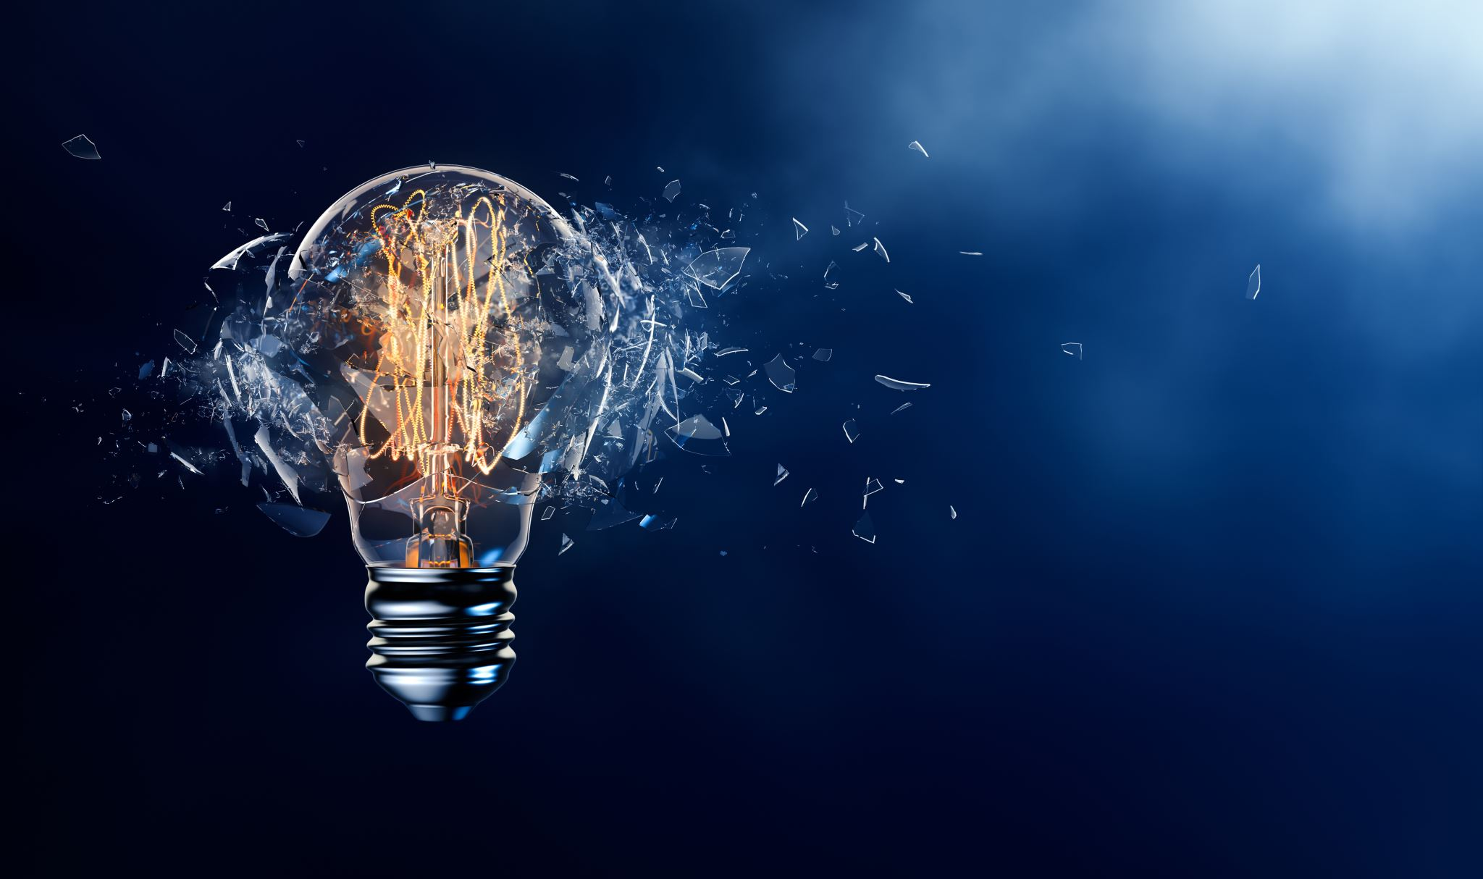

Conductors
Insulators tend to refract light
Conductors tend to absorb then release
Rate of release affects reflected light
Can be expressed as complex number
Real part = index of refraction
Imaginary part = coefficient of extinction $κ$
COMP 5812M: Foundations of Modelling & Rendering

Slide 30
Simpler Approach
Treat refraction and extinction separately
Fresnel reflectance then becomes
But this doesn't cover everything
Phenomena such as birefringence (refraction that depends on polarization)

Slide 31
Without Polarisation
Graphics usually assumes no polarisation
Makes computations much easier
Simplifies Fresnel equations to:

Slide 32
Moving to Calculus
All of this is per photon
But there are many photons
At least 10²³ in practice
So we assume a continuous function
called a density function
Provided that the integral comes out right

Slide 33
Solid Angles
A radian subtends a unit arc
A steradian subtends a unit area

Slide 34
Change of Variables
becomes
becomes
We often have rectangular patches
We want to integrate in steradians
This involves a change of variables

Slide 35
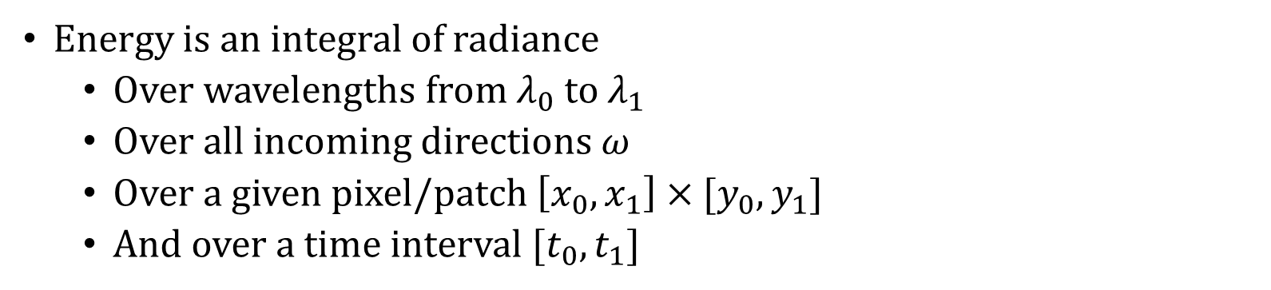
Integrating Radiance
Energy is an integral of radiance
Over wavelengths from $λ_{0}$ to $λ_{1}$
Over all incoming directions $ω$
Over a given pixel/patch $\left[x_{0},x_{1}\right]×[y_{0},y_{1}]$
And over a time interval $[t_{0},t_{1}]$

Slide 36
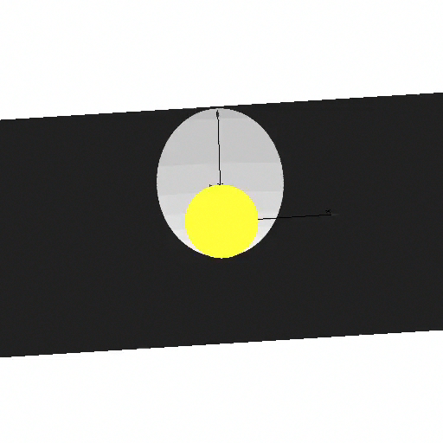
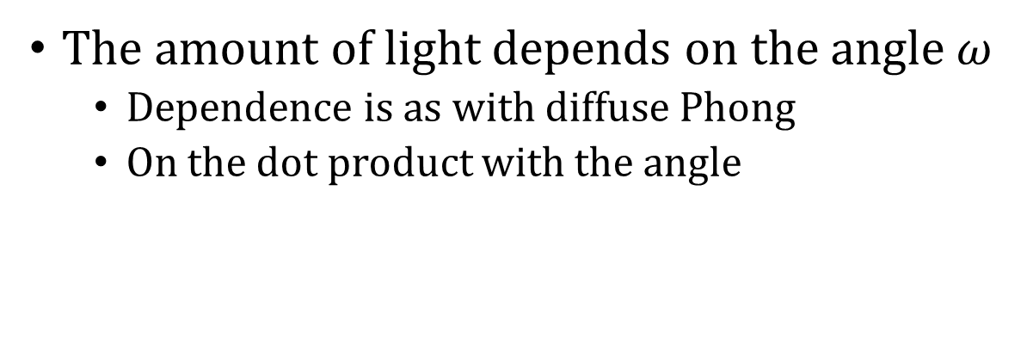
But . . .
becomes
becomes
The amount of light depends on the angle $ω$
Dependence is as with diffuse Phong
On the dot product with the angle

Slide 37
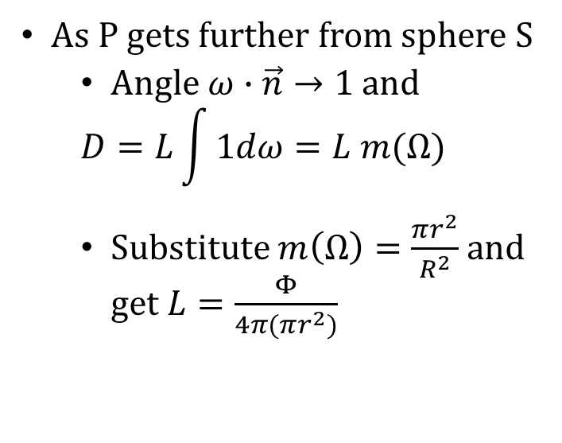
A Lambertian Emitter
As P gets further from sphere S
Angle $ω∙\vec{n}→1$ and
$$D=L\int{1dω}=L m(Ω)$$
Substitute $m\left(Ω\right)=\frac{πr^{2}}{R^{2}}$ and get $L=\frac{Φ}{4π(πr^{2})}$
COMP 5812M: Foundations of Modelling & Rendering

Slide 38
Irradiance
Similarly, we can simplify the irradiance
By substituting assumptions

Slide 39
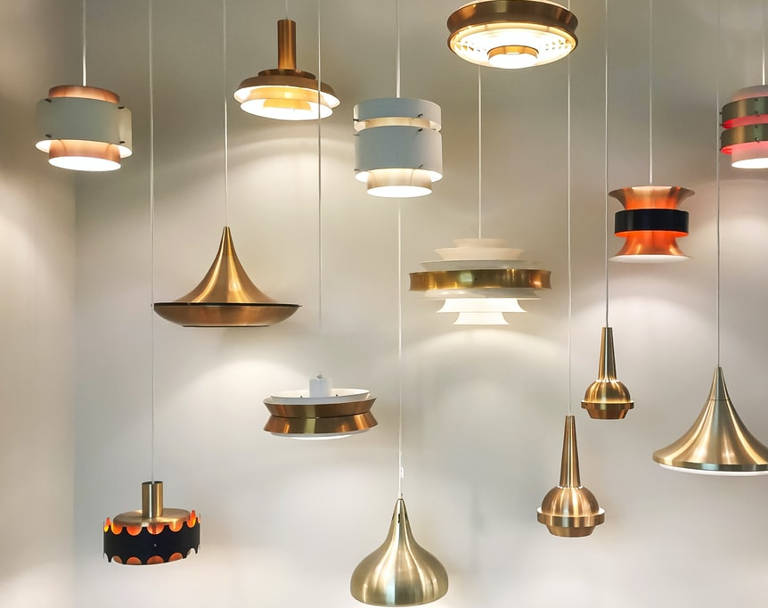
Types of Light Source
Sunlight (aka white light)
Black-body radiation at c. 6000℃
Incandescent Bulb (Tungsten)
Black-body radiation at c. 2500℃
Fluorescent Lamp (Mercury)
Stimulated emission with phosphorescence
LED
Direct stimulated emission
COMP 5812M: Foundations of Modelling & Rendering

Slide 40
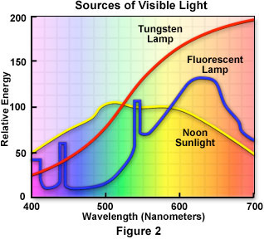
Spectral Distribution
“White” light

Slide 41
A Fluorescent Lamp
Note the spikes (impulses)
Phosphors chosen so that result looks white
i.e. perceptually close to sunlight

Slide 42
LED Lights
LEDs are light-emitting diodes
Close to mono-spectral
i.e. output only one wavelength
COMP 5812M: Foundations of Modelling & Rendering

Slide 43
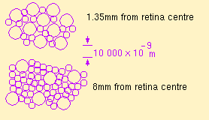
The Retina
A patchwork of light-sensitive cells
Rods: low light conditions (B/W)
Cones: ordinary conditions (colour)
Cones
Rods

Slide 44
Photopic & Scotopic Vision
Photopic vision uses the cones
Scotopic (night) vision uses the rods
And their efficiency is different
Scotopic vision has trouble with red
COMP 5812M: Foundations of Modelling & Rendering

Slide 45
Cones & Colour
Three types of cones
Respond to different wavelengths
Integrate over a range of wavelengths
COMP 5812M: Foundations of Modelling & Rendering

Slide 46
Luminous Efficiency
The eye works best with greenish light
Other wavelengths fall off in response
So blue cones are overall weak

Slide 47
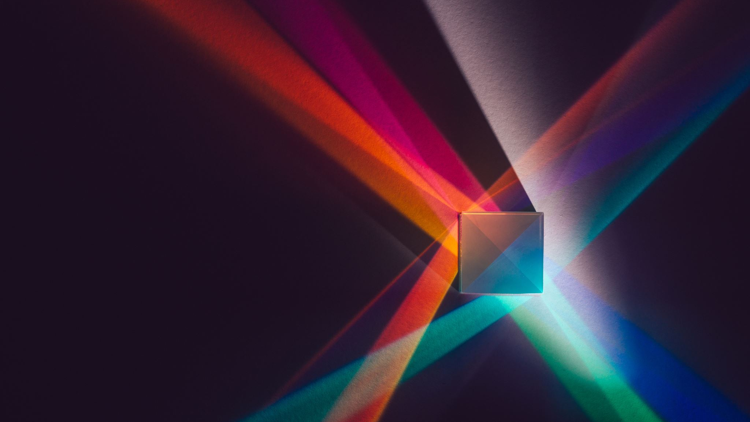

Luminance
Perceived brightness
Integrate total energy over all wavelengths
$\int{I\left(λ\right)e\left(λ\right)dλ}$
Notice we've now included human response
So this is based on perceptual studies
Averages over a population
COMP 5812M: Foundations of Modelling & Rendering

Slide 48
Tri-stimulus Theory
Mix R, G & B to get any colour desired
Human can’t tell the difference
But you need negative red light to do it
COMP 5812M: Foundations of Modelling & Rendering

Slide 49
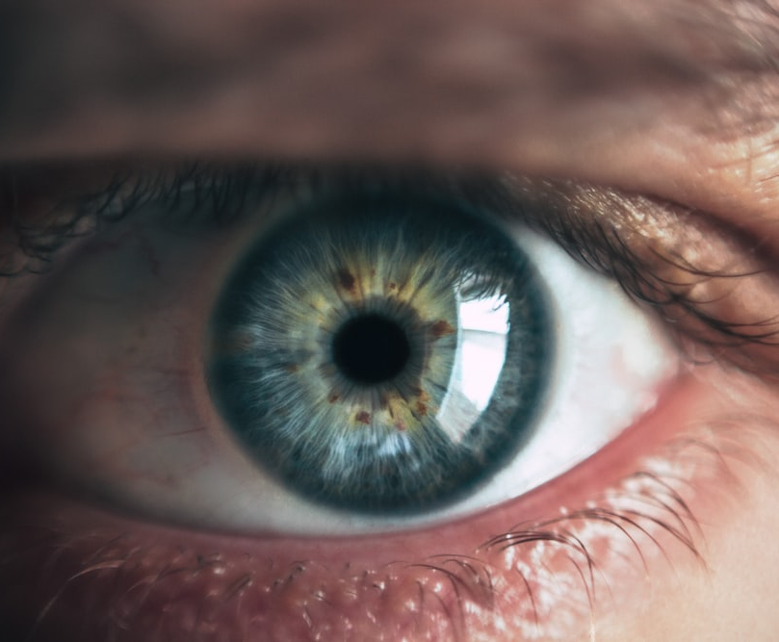
Adaptation
The eyes use slow chemical reactions
But they adapt to the light level
So their response is (mostly) logarithmic
But too much light washes an image out
Even in the areas where it's dark
COMP 5812M: Foundations of Modelling & Rendering

Slide 50

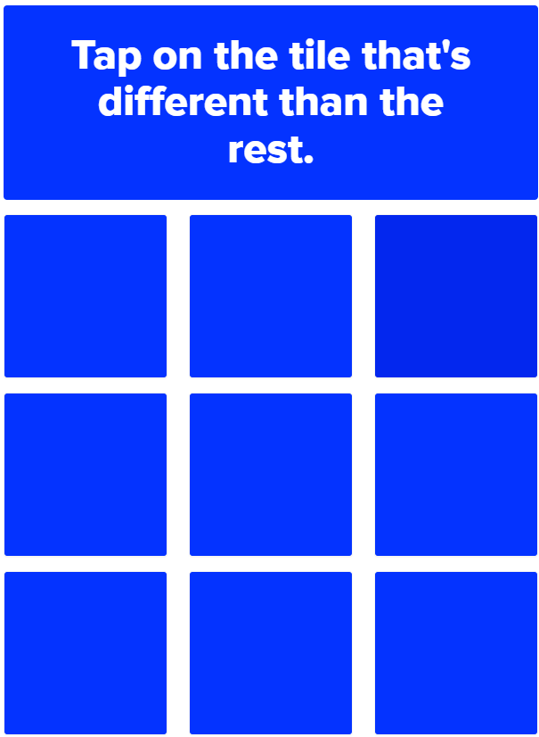
Just Noticeable Difference
Humans can just spot a 1% difference
at least in the range that displays use
So we need about 100 logarithmic levels
And 256 values is enough most of the time
Hence our 8-bit RGB values
But they’re not uniform
So we use gamma correction
COMP 5812M: Foundations of Modelling & Rendering

Slide 51
Radiance to Pixel Value
OpenGL/PPM use a simple model:
0-255 / 0.0 – 1.0 in each colour channel
Human vision isn’t like this
We see a wide range of intensity
Closer to 0.0 – 1,000,000
But it’s logarithmic in nature
And we have to adjust for it
COMP 5812M: Foundations of Modelling & Rendering

Slide 52
Gamma encoding
Assume we have
radiance r
min & max possible r
Δr = (max – min) / 1.0
Then we compute
With γ = 2.2 (to match the human eye)

Slide 53
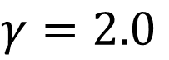
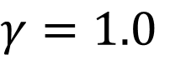
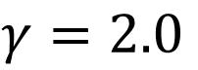
Gamma Examples
$$γ=2.0$$
$$γ=1.0$$
$$γ=2.0$$
(subject to monitor gamma, &c.)
Compute in float
Use gamma to convert to integers

Slide 54
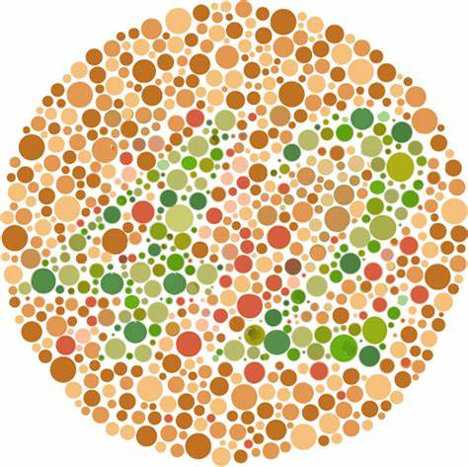
Colour Blindness
About 8-10% of men, 1% of women
Most common is red-green
only one cone for both red & green
Yellow-blue also occurs
And some people only have one type of cone
Remember to design for colour blindness
NEVER rely only on colour

Slide 55
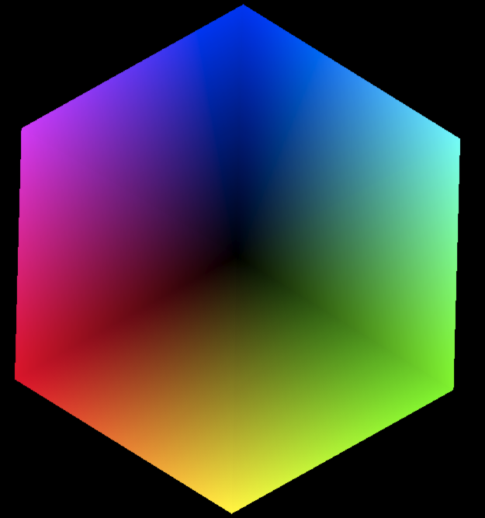
Blue
Magenta
Cyan
RGB Colour Cube
Black
Red
Green
Yellow

Slide 56
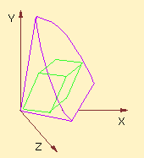
XYZ Colour Space
By the CIE (Commission Internationale d’Eclairage)
Every visible colour uses positive coords
Visible Colours
RGB Cube

Slide 57
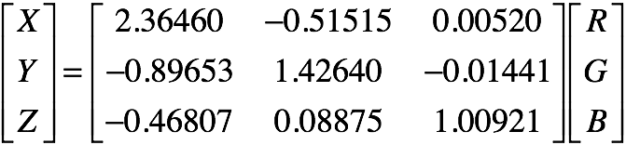
RGB to XYZ
Just a matrix transformation
Converts between different colour systems
COMP 5812M: Foundations of Modelling & Rendering

Slide 58
CIE Chromaticity Diagram
Project colour space to plane X + Y + Z = 1
Pure colours appear along the edge

Slide 59
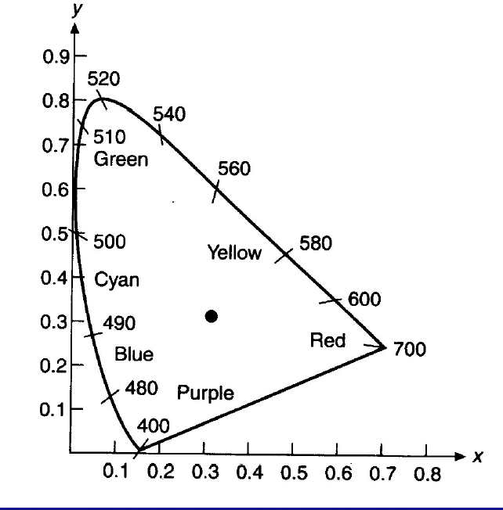
sRGB Gamut
Y
Set of colours possible with standard RGB (sRGB)
Convex hull of positions on the diagram
Each device has a gamut
Used to calibrate colour perception
Still a major problem
Z
X
COMP 5812M: Foundations of Modelling & Rendering

Slide 60
YUV Colour Space
Early TV was a monochrome signal
Measured total intensity Y of light
Axis from black to white
Colour TV is backward compatible
Y component is still transmitted
Components U,V were added
COMP 5812M: Foundations of Modelling & Rendering

Slide 61
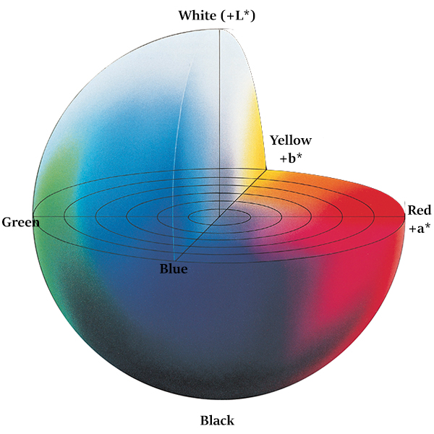
CIELAB Color space
Perceptually uniform space:
Separates light and chromacity (similarly to YUV)
But in this case not focused on transmission, but perception.
A change of X in one of the axis should match how much change is perceived.
Computing in 8 bits will break things. Use floats
From konicaminolta

Slide 62
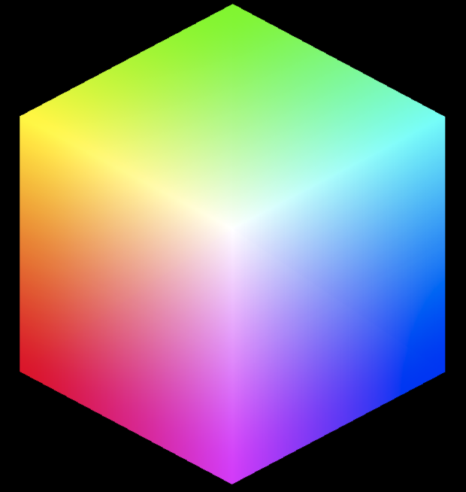
HSV Colour Space
Saturation
(radius)
The colour wheel
H - hue
S - saturation
V - value
(or B - brightness)
Hue
(angle)
COMP 5812M: Foundations of Modelling & Rendering

Slide 63
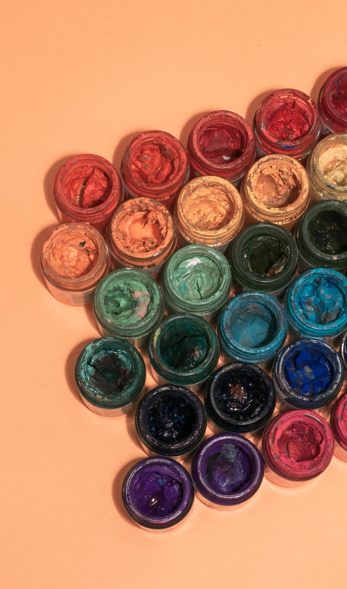
Choosing Colours
How do we get “yellow”?
start with the rainbow: R O Y G B I V
mix R & G to get Y
Or look at the colour wheel
Or just play with RGB until we get it right
COMP 5812M: Foundations of Modelling & Rendering

Slide 64
Additive Colour
These models assume light is added
Colour is the sum of components
Suitable for combining light sources
But this isn’t the only way of doing it
Go back to the physics again
COMP 5812M: Foundations of Modelling & Rendering

Slide 65
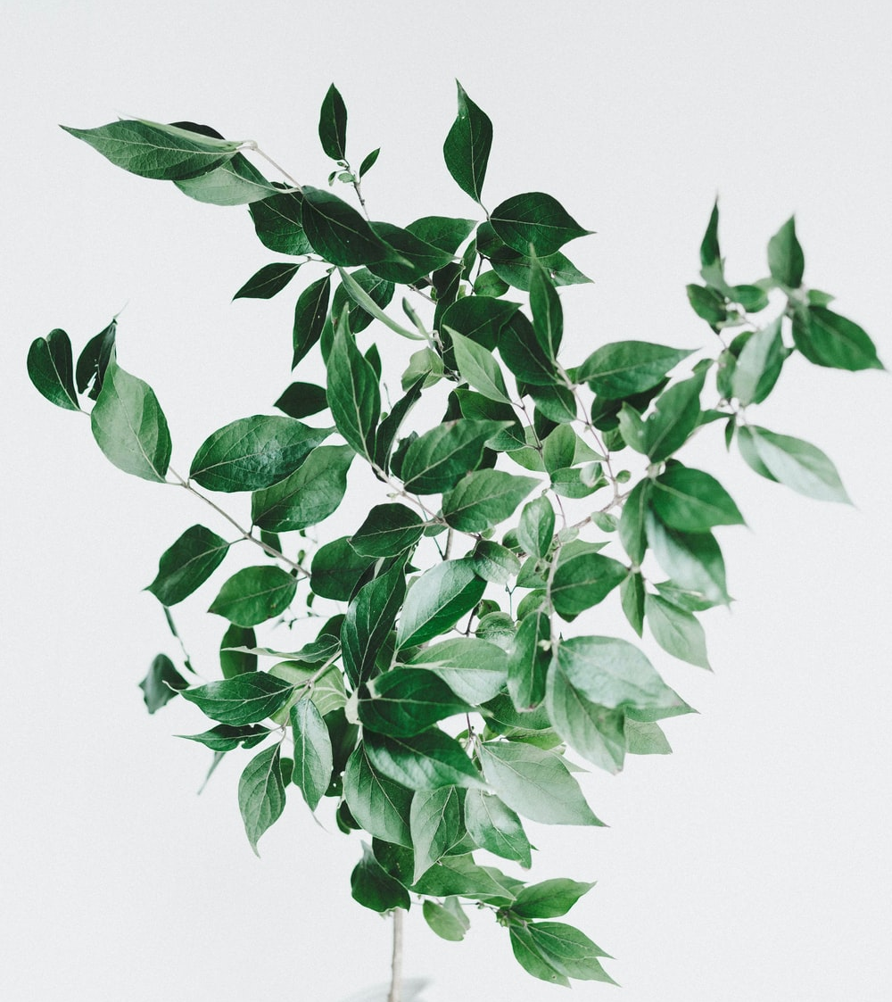
Colour Absorption
Objects are coloured by pigments
that absorb certain colours of light
E.g. chlorophyll in leaves
absorbs almost all red / blue light
but reflects green light
so output light is green
COMP 5812M: Foundations of Modelling & Rendering

Slide 66
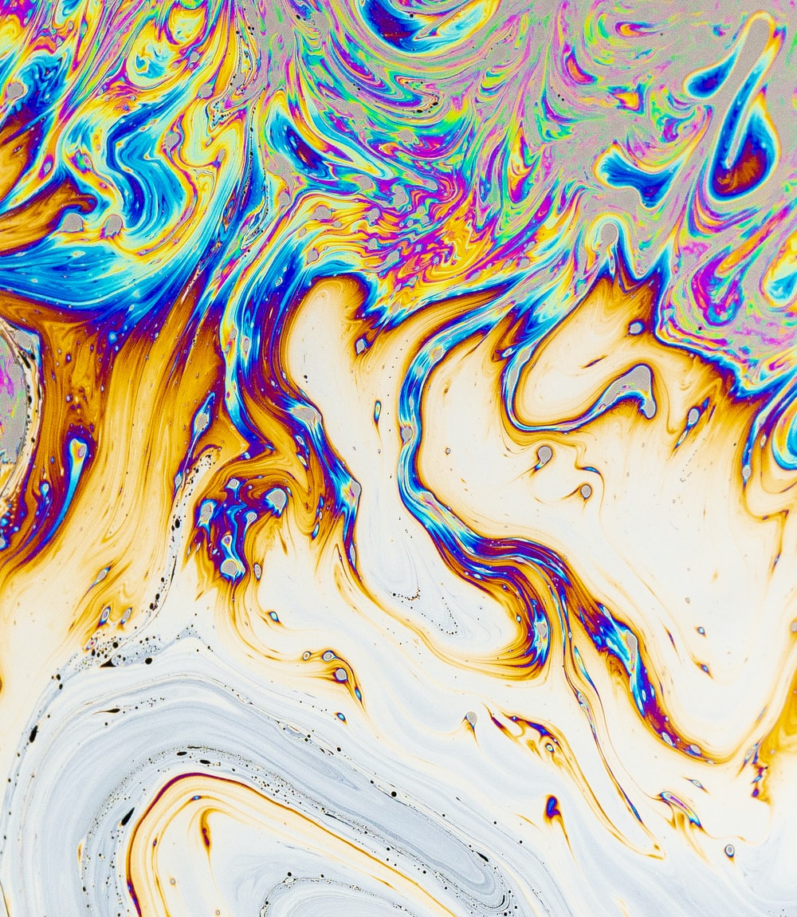
Subtractive Colour
For pigments, we subtract colour
Blue + Yellow = Green
blue reflects some green as well
so does yellow
green is only colour reflected by both
We learned this colour model in school
COMP 5812M: Foundations of Modelling & Rendering

Slide 67
CMYK model
Printers use CMYK
Cyan removes red
Magenta removes green
Yellow removes blue
Black removes everything
Question: Can you run out of color ink just printing black and white?
Green
Yellow
Cyan
White
Red
Blue
Magenta
COMP 5812M: Foundations of Modelling & Rendering

Slide 68
Tone Perception
Cones don't act separately
Retina combines signals from cones
Perception is affected by context
Which set of squares is lighter?
COMP 5812M: Foundations of Modelling & Rendering

Slide 69
Simultaneous Contrast
Tone perception also occurs in colour
Which greys are the same here?
COMP 5812M: Foundations of Modelling & Rendering

Slide 70
Colour Interpolation
Interpolating nearby colours works well
Interpolating distant colours usually fails
So films are starting to add wavelengths
Known as spectral rendering
Will we end up with ROYGBIV devices?
Time will tell
In the meantime, assume RGB
COMP 5812M: Foundations of Modelling & Rendering

Slide 71
Images by
S3: Braxton Apana
S4 S10: Sigmund
S21: Alexandra Tran
S22: Robbie Dawn
S25: FLY:D
S26: ThomasCarlPion
S29: Etienne Girardet
S49: Victor Freitas
S62: Sarah Arista
S65: Tanalee Youngblood
S66: Daniel Olah
S50: buzzfeed.com

